Slide 1

Database Systems: Design, Implementation, and Management
Eighth Edition
Chapter 13
Business Intelligence and Data Warehouses

Slide 2
Objectives
In this chapter, you will learn:
  How business intelligence is a comprehensive framework to support business decision making
  How operational data and decision support data differ
  What a data warehouse is, how to prepare data for one, and how to implement one
  What star schemas are and how they are constructed
Database Systems, 8th Edition

Slide 3
Objectives (continued):
In this chapter, you will learn: (continued)
  What data mining is and what role it plays in decision support
  About online analytical processing (OLAP)
  How SQL extensions are used to support OLAP-type data manipulations
Database Systems, 8th Edition

Slide 4
The Need for Data Analysis
Managers track daily transactions to evaluate how the business is performing
Strategies should be developed to meet organizational goals using operational databases
Data analysis provides information about short-term tactical evaluations and strategies
Database Systems, 8th Edition

Slide 5
Business Intelligence
Comprehensive, cohesive, integrated tools and processes
  Capture, collect, integrate, store, and analyze data
  Generate information to support business decision making
Framework that allows a business to transform:
  Data into information
  Information into knowledge
  Knowledge into wisdom
Database Systems, 8th Edition

Slide 6
Business Intelligence Architecture
Composed of data, people, processes, technology, and management of components
Focuses on strategic and tactical use of information
Key performance indicators (KPI)
  Measurements that assess company’s effectiveness or success in reaching goals
Multiple tools from different vendors can be integrated into a single BI framework
Database Systems, 8th Edition

Slide 7
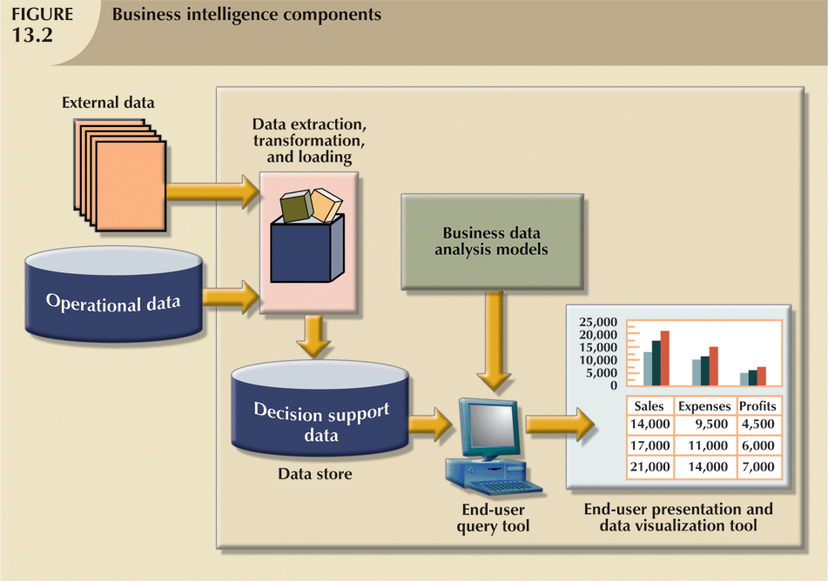
Database Systems, 8th Edition

Slide 8
Decision Support Data
Operational data
  Mostly stored in relational database
  Optimized to support transactions representing daily operations
Decision support data differs from operational data in three main areas:
  Time span
  Granularity
  Dimensionality
Database Systems, 8th Edition

Slide 9
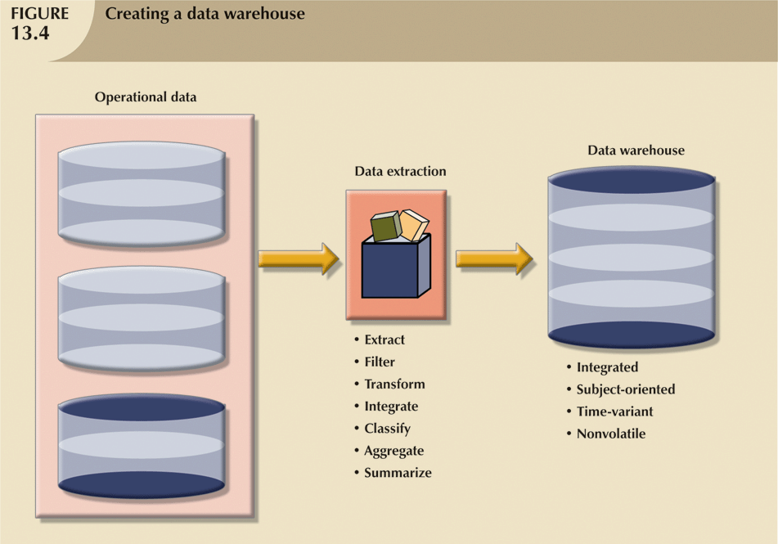
Database Systems, 8th Edition

Slide 10
Decision Support
Database Requirements
Specialized DBMS tailored to provide fast answers to complex queries
Four main requirements:
  Database schema
  Data extraction and loading
  End-user analytical interface
  Database size
Database Systems, 8th Edition

Slide 11
Decision Support
Database Requirements (continued)
Database schema
  Complex data representations
  Aggregated and summarized data
  Queries extract multidimensional time slices
Data extraction and filtering
  Supports different data sources
    Flat files
    Hierarchical, network, and relational databases
    Multiple vendors
  Checking for inconsistent data
Database Systems, 8th Edition

Slide 12
Decision Support
Database Requirements (continued)
End-user analytical interface
  One of most critical DSS DBMS components
  Permits user to navigate through data to simplify and accelerate decision-making process
Database size
  In 2005, Wal-Mart had 260 terabytes of data in its data warehouses
  DBMS must support very large databases (VLDBs)
Database Systems, 8th Edition

Slide 13
The Data Warehouse
Integrated, subject-oriented, time-variant, and nonvolatile collection of data
  Provides support for decision making
Usually a read-only database optimized for data analysis and query processing
Requires time, money, and considerable managerial effort to create
Database Systems, 8th Edition

Slide 14
The Data Warehouse (continued)
Data mart
  Small, single-subject data warehouse subset
  More manageable data set than data warehouse
  Provides decision support to small group of people
  Typically lower cost and lower implementation time than data warehouse
Database Systems, 8th Edition

Slide 15
Twelve Rules that Define a Data Warehouse
Data warehouse and operational environments are separated
Data warehouse data are integrated
Data warehouse contains historical data over long time
Data warehouse data are snapshot data captured at given point in time
Data warehouse data are subject-oriented
Database Systems, 8th Edition

Slide 16
Twelve Rules that Define a Data Warehouse (continued)
Data warehouse data are mainly read-only
  Periodic batch updates from operational data
  No online updates allowed
Data warehouse development life cycle differs from classical systems development
Data warehouse contains data with several levels of detail:
  Current detail data, old detail data, lightly summarized data, and highly summarized data
Database Systems, 8th Edition

Slide 17
Twelve Rules that Define a Data Warehouse (continued)
Read-only transactions to very large data sets
Data warehouse environment traces data sources, transformations, and storage
Data warehouse’s metadata are critical component of this environment
Data warehouse contains chargeback mechanism for resource usage
  Enforces optimal use of data by end users
Database Systems, 8th Edition

Slide 18
Decision Support Architectural Styles
Provide advanced decision support features
Some capable of providing access to multidimensional data analysis
Complete data warehouse architecture supports:
  Decision support data store
  Data extraction and integration filter
  Specialized presentation interface
Database Systems, 8th Edition

Slide 19
Online Analytical Processing
Advanced data analysis environment that supports:
  Decision making
  Business modeling
  Operations research
Four main characteristics:
  Use multidimensional data analysis techniques
  Provide advanced database support
  Provide easy-to-use end-user interfaces
  Support client/server architecture
Database Systems, 8th Edition

Slide 20
Multidimensional Data Analysis Techniques
Data are processed and viewed as part of a multidimensional structure
Augmented by the following functions:
  Advanced data presentation functions
  Advanced data aggregation, consolidation, and classification functions
  Advanced computational functions
  Advanced data modeling functions
Database Systems, 8th Edition

Slide 21
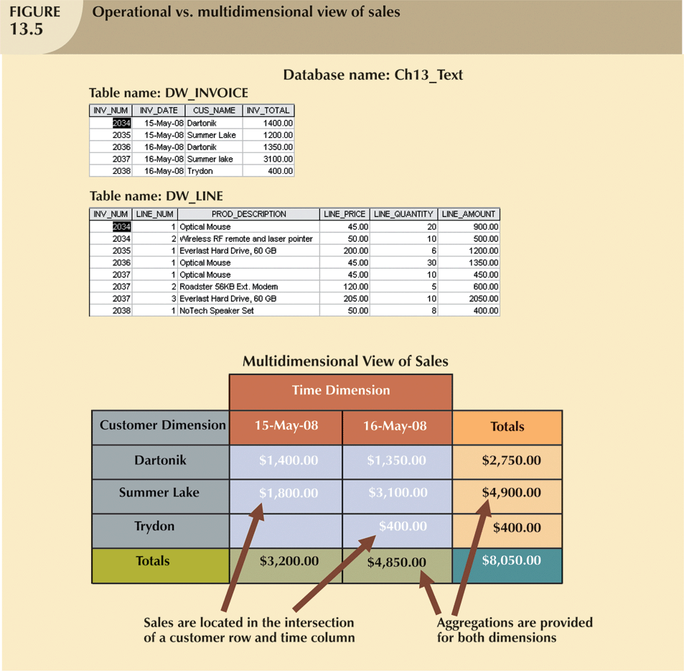
Database Systems, 8th Edition

Slide 22
Advanced Database Support
Advanced data access features include:
  Access to many different kinds of DBMSs, flat files, and internal and external data sources
  Access to aggregated data warehouse data
  Advanced data navigation
  Rapid and consistent query response times
  Maps end-user requests to appropriate data source and to proper data access language
  Support for very large databases
Database Systems, 8th Edition

Slide 23
Easy-to-Use End-User Interface
Advanced OLAP features more useful when access is simple
Many interface features are “borrowed” from previous generations of data analysis tools
  Already familiar to end users
  Makes OLAP easily accepted and readily used
Database Systems, 8th Edition

Slide 24
Client/Server Architecture
Provides framework for design, development, implementation of new systems
  Enables OLAP system to be divided into several components that define its architecture
  OLAP is designed to meet ease-of-use as well as system flexibility requirements
Database Systems, 8th Edition

Slide 25
OLAP Architecture
Operational characteristics’ three main modules:
  Graphical user interface (GUI)
  Analytical processing logic
  Data-processing logic
Designed to use both operational and data warehouse data
In most implementations, data warehouse and OLAP are interrelated and complementary
OLAP systems merge data warehouse and data mart approaches
Database Systems, 8th Edition

Slide 26
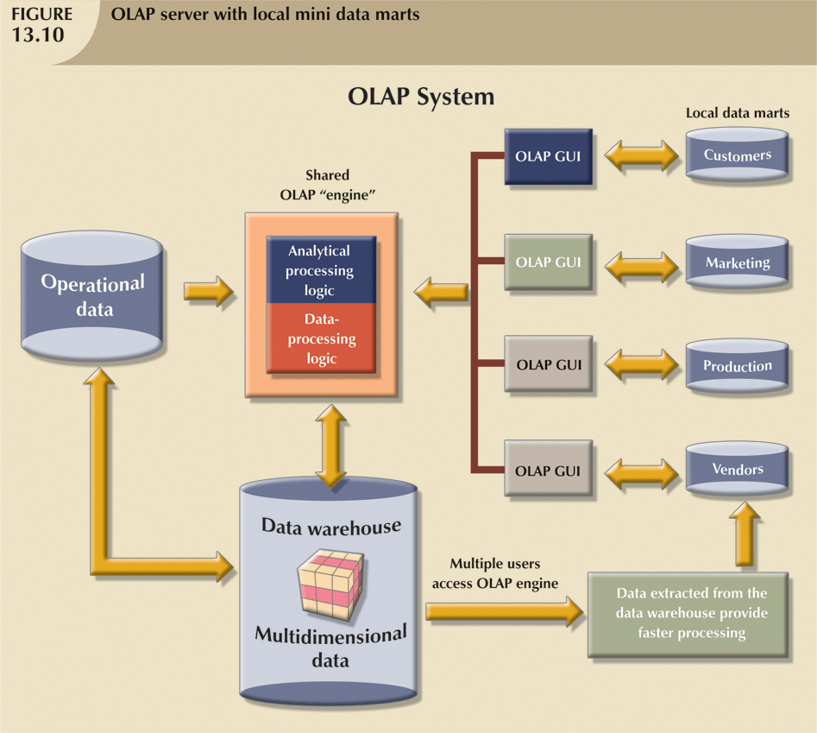
Database Systems, 8th Edition

Slide 27
Relational OLAP
Uses relational databases and relational query tools
  Stores and analyzes multidimensional data
Adds following extensions to traditional RDBMS:
  Multidimensional data schema support within RDBMS
  Data access language and query performance optimized for multidimensional data
  Support for very large databases
Database Systems, 8th Edition

Slide 28
Multidimensional OLAP
Extends OLAP functionality to multidimensional database management systems (MDBMSs)
  MDBMS end users visualize stored data as a 3D data cube
  Data cubes can grow to n dimensions, becoming hypercubes
  To speed access, data cubes are held in memory in a cube cache
Database Systems, 8th Edition

Slide 29
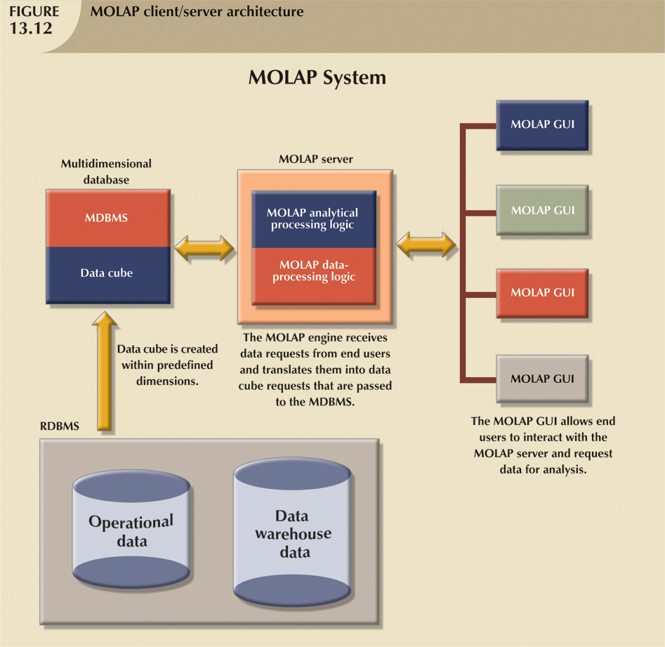
Database Systems, 8th Edition

Slide 30
Relational vs. Multidimensional OLAP
Selection of one or the other depends on evaluator’s vantage point
Proper evaluation must include supported hardware, compatibility with DBMS, etc.
ROLAP and MOLAP vendors working toward integration within unified framework
Relational databases use star schema design to handle multidimensional data
Database Systems, 8th Edition

Slide 31
Star Schema
Data modeling technique
  Maps multidimensional decision support data into relational database
Creates near equivalent of multidimensional database schema from relational data
Easily implemented model for multidimensional data analysis
  Preserves relational structures on which operational database is built
Four components: facts, dimensions, attributes, and attribute hierarchies
Database Systems, 8th Edition

Slide 32
Facts
Numeric measurements that represent specific business aspect or activity
  Normally stored in fact table that is center of star schema
Fact table contains facts linked through their dimensions
Metrics are facts computed at run time
Database Systems, 8th Edition

Slide 33
Dimensions
Qualifying characteristics provide additional perspectives to a given fact
Decision support data almost always viewed in relation to other data
Study facts via dimensions
Dimensions stored in dimension tables
Database Systems, 8th Edition

Slide 34
Attributes
Use to search, filter, and classify facts
Dimensions provide descriptions of facts through their attributes
No mathematical limit to the number of dimensions
Slice and dice: focus on slices of the data cube for more detailed analysis
Database Systems, 8th Edition

Slide 35
Attribute Hierarchies
Provide top-down data organization
Two purposes:
  Aggregation
  Drill-down/roll-up data analysis
Determine how the data are extracted and represented
Stored in the DBMS’s data dictionary
Used by OLAP tool to access warehouse properly
Database Systems, 8th Edition

Slide 36
Star Schema Representation
Facts and dimensions represented in physical tables in data warehouse database
Many fact rows related to each dimension row
  Primary key of fact table is a composite primary key
  Fact table primary key formed by combining foreign keys pointing to dimension tables
Dimension tables smaller than fact tables
Each dimension record related to thousands of fact records
Database Systems, 8th Edition

Slide 37
Performance-Improving Techniques for the Star Schema
Four techniques to optimize data warehouse design:
  Normalizing dimensional tables
  Maintaining multiple fact tables to represent different aggregation levels
  Denormalizing fact tables
  Partitioning and replicating tables
Database Systems, 8th Edition

Slide 38
Performance-Improving Techniques for the Star Schema (continued)
Dimension tables normalized to:
  Achieve semantic simplicity
  Facilitate end-user navigation through the dimensions
Denormalizing fact tables improves data access performance and saves data storage space
Partitioning splits table into subsets of rows or columns
Replication makes copy of table and places it in different location
Database Systems, 8th Edition

Slide 39
Implementing a Data Warehouse
Numerous constraints, including:
  Available funding
  Management’s view of role played by an IS department
    Extent and depth of information requirements
  Corporate culture
No single formula can describe perfect data warehouse development
Database Systems, 8th Edition

Slide 40
The Data Warehouse as an Active Decision Support Framework
Data warehouse:
  Is not a static database
  Is a dynamic framework for decision support that is always a work in progress
Data warehouse is critical component of modern BI environment
Design and implementation must be examined as part of entire infrastructure
Database Systems, 8th Edition

Slide 41
A Company-Wide Effort That Requires User Involvement
Data warehouse data cross departmental lines and geographical boundaries
Building a data warehouse requires the designer to:
  Involve end users in process
  Secure end users’ commitment from beginning
  Create continuous end-user feedback
  Manage end-user expectations
  Establish procedures for conflict resolution
Database Systems, 8th Edition

Slide 42
Satisfy the Trilogy:
Data, Analysis, and Users
Data warehouse designer must satisfy:
  Data integration and loading criteria
  Data analysis capabilities with acceptable query performance
  End-user data analysis needs
Database Systems, 8th Edition

Slide 43
Apply Database Design Procedures
Company-wide effort requiring many resources
Quantity of data requires latest hardware and software
Detailed procedures to orchestrate flow of data from operational databases to data warehouse
People with advanced database design, software integration, and management skills
Database Systems, 8th Edition

Slide 44
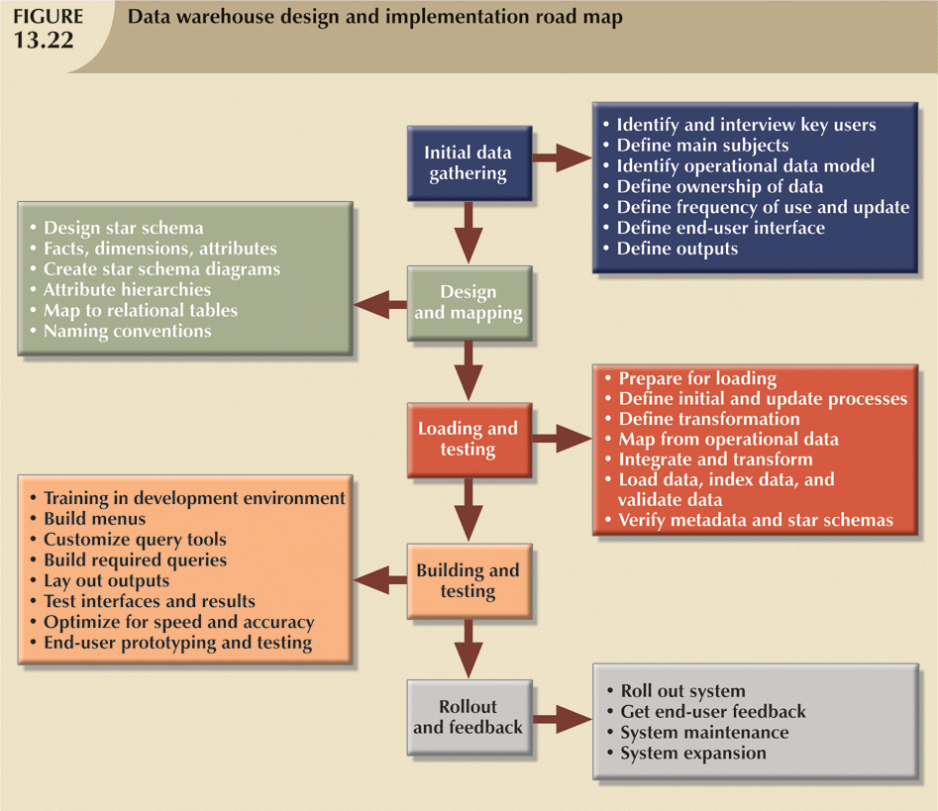
Database Systems, 8th Edition

Slide 45
Data Mining
Data-mining tools do the following:
  Analyze data
  Uncover problems or opportunities hidden in data relationships
  Form computer models based on their findings
  Use models to predict business behavior
Requires minimal end-user intervention
Database Systems, 8th Edition

Slide 46
SQL Extensions for OLAP
Proliferation of OLAP tools fostered development of SQL extensions
Many innovations have become part of standard SQL
All SQL commands will work in data warehouse as expected
Most queries include many data groupings and aggregations over multiple columns
Database Systems, 8th Edition

Slide 47
The ROLLUP Extension
Used with GROUP BY clause to generate aggregates by different dimensions
GROUP BY generates only one aggregate for each new value combination of attributes
ROLLUP extension enables subtotal for each column listed except for the last one
  Last column gets grand total
Order of column list important
Database Systems, 8th Edition

Slide 48
The CUBE Extension
CUBE extension used with GROUP BY clause to generate aggregates by listed columns
  Includes the last column
Enables subtotal for each column in addition to grand total for last column
Useful when you want to compute all possible subtotals within groupings
Cross-tabulations good application of CUBE extension
Database Systems, 8th Edition

Slide 49
Materialized Views
A dynamic table that contains SQL query command to generate rows
  Also contains the actual rows
Created the first time query is run and summary rows are stored in table
Automatically updated when base tables are updated
Database Systems, 8th Edition

Slide 50
Summary
Business intelligence generates information used to support decision making
BI covers a range of technologies, applications, and functionalities
Decision support systems were the precursor of current generation BI systems
Operational data not suited for decision support
Database Systems, 8th Edition

Slide 51
Summary (continued)
Four categories of requirements for decision support DBMS:
  Database schema
  Data extraction and loading
  End-user analytical interface
  Database size requirements
Data warehouse provides support for decision making
  Usually read-only
  Optimized for data analysis, query processing
Database Systems, 8th Edition

Slide 52
Summary (continued)
OLAP systems have four main characteristics:
  Use of multidimensional data analysis
  Advanced database support
  Easy-to-use end-user interfaces
  Client/server architecture
ROLAP provides OLAP functionality with relational databases
MOLAP provides OLAP functionality with MDBMSs
Database Systems, 8th Edition

Slide 53
Summary (continued)
Star schema is a data-modeling technique
  Maps multidimensional decision support data into a relational database
Star schema has four components:
  Facts
  Dimensions
  Attributes
  Attribute hierarchies
Database Systems, 8th Edition

Slide 54
Summary (continued)
Four techniques optimize data warehouse design:
  Normalize dimensional tables
  Maintain multiple fact tables
  Denormalize fact tables
  Partition and replicate tables
Data mining automates analysis of operational data
SQL extensions support OLAP-type processing and data generation
Database Systems, 8th Edition

